Slide 1
Presentation for the South Carolina Oversight Committee
School District Efficiency Reviews Proviso 1.95 of the 2014-15 General Appropriations Act
Barnwell 19 – 744 students
Clarendon 1 – 807 students
Dorchester 2 – 25,000 students
Lexington 4 – 3,438 students
June 8, 2015
Presented by Tidwell & Associates, Inc.
1

Slide 2
PRESENTATION OVERVIEW
OVERVIEW OF TIDWELL AND ASSOCIATES AND TEAM
OVERVIEW OF REVIEW METHODOLOGY
DISTRICT COMMENDATIONS/ RECOMMENDATIONS
FISCAL IMPACTS FOR EACH DISTRICT
GLOBAL ISSUES FOUND ACROSS DISTRICTS
SUGGESTED NEXT STEPS FOR ADDITIONAL REVIEWS
1

Slide 3
Tidwell & Associates, Inc
(Columbia-based firm)
28 year history of providing evaluation, reviews, studies (nationwide)
Local, state, and federal experience Team Composition – Total of 12 Consultants Team Leads:
Mr. Ritchie Tidwell- Quality Control
Dr. JoAnn Cox-Project Director /District Organization and Management
Dr. Tom Houlihan-Technical Advisor
Our other experts in school district operations included:
In and out-of-state experts;
3 team members worked previously as department heads at the SC DOE;
Former award winning superintendents, principals, and teachers;
Policy advisors for SC governors;
Two attorneys;
Certified public accountants; and
Chief technology officers.
3

Slide 4
Methodology
Review of Existing Data
Peer District Comparisons (Agreed upon with EOC, district, and Tidwell and Assoc.)
Preliminary Review
Staff Surveys
Onsite Review
12 consultants conducted the reviews
Interviews, focus groups with staff and board members
Site visits to district schools
Community Open House
3

Slide 5
Total District Commendations/Recommendations
Barnwell 19 – 22 Commendations/ 62 Recommendations
Clarendon 1 – 31 Commendations/ 48 Recommendations
Dorchester 2 – 22 Commendations/
60 Recommendations
Lexington 4 – 37 Commendations/ 70 Recommendations
3

Slide 6
TOTAL FIRST -YEAR ESTIMATED SAVINGS -4 SC
DISTRICTS
$1,618,466
TOTAL FIVE-YEAR ESTIMATED SAVINGS – 4 SC
DISTRICTS
$11,784,684
SINCE 2003, VIRGINIA STATEWIDE EFFICIENCY REVIEW PROGRAM OF 41 DISTRICTS
ANNUAL ACTUAL SAVINGS
$44,934,442
3

Slide 7
Five Year Savings/Costs By District and Operational Area
Operational Areas Reviewed | Dorchester 2 | Lexington 4 | Barnwell 19 | Clarendon 1 | Total 5 year Savings/Cost across all districts by operational area
Organization & Management | $2,205,600 | ($189,050) | ($249,750) | $450 | $1,767,250
Financial Management | $45,816 | ($30,939) | ($39,100) | $12,661 | ($11,562)
Human Resources | ($243,475) | ($2,500) | $673,785 | $109,110 | $536,920
Facility Use & Energy Management | $3,405,795 | ($264,791) | ($443,000) | $128,929 | $2,826,933
Transportation | $274,000 | $126,473 | ($66,162) | $70,608 | $404,919
Food Services | $2,513,544 | $100,000 | $1,633,033 | ($9,700) | $4,236,877
Technology | $1,136,494 | $691,300 | $81,470 | $114,083 | $2,023,347
Grand Total 5-year savings | $9,337,774 | $460,493 | $1,590,276 | $426,141 | $11,784,684
*Note: Three of the four districts are not requesting the maximum revenue annually permitted by state law. The additional funding would, among other things, help to pay for some of our recommendations that require costs.
For example, based on FY 14-15, in Lexington 4, the foregone revenue was $149,914.99. If the school board does not subsequently impose a millage increase, then over a five-year period the foregone revenue total is $749,574.95
3

Slide 8
District Organization and Management
(SELECTED GLOBAL FINDINGS/FUTURE CONSIDERATION)
Need to study and consider shared central office services of the smaller, rural districts.
Need for a statewide analysis of the use and resources provided by the state’s consortia; these appear to be an untapped resource (i.e., Pee Dee Education Center in Florence and the Western Piedmont Education Consortium in Greenwood, and Old English Consortium.)
Lack of consistency in the evaluation of superintendents although there is a best practice model offered by the South Carolina School Boards’ Association (SCSBA) .
8

Slide 9
District Organization and Management
(SELECTED GLOBAL FINDINGS/FUTURE CONSIDERATION)
The role and cost-effectiveness of county boards of education needs to be reviewed/studied at the local level. (ie., the county board that oversees the multiple Clarendon districts called the Clarendon Board of Education and the Anderson & Dillon Boards of Education)
There is inconsistency in the monthly stipend for school board members. No pay up to $600 a month; more for board chairs
Stronger training for Board members is needed particularly in understanding their roles as policymakers.
8

Slide 10
District Organization and Management
(SELECTED GLOBAL FINDINGS/FUTURE CONSIDERATION)
The state collects districts’ strategic plans prior to the districts receiving their state student testing data (PASS). Plans are typically based on student academic needs. Plans should be submitted to the state after districts have had an opportunity to study their current test scores.
Districts report that there are no state expectations for districts’ Response to Intervention program (RtI).

Slide 11
Financial Management
(SELECTED GLOBAL FINDINGS/FUTURE CONSIDERATION)
All of the 4 districts could use an independent review of their insurance coverage.
2 of the 4 districts were not taking full advantage of their 8% borrowing capacity to fund capital improvements.
There is a need for districts to study Medicaid reimbursements each fiscal year for opportunities to increase the amounts received.

Slide 12
Human Resources
(SELECTED GLOBAL FINDINGS/FUTURE CONSIDERATION)
The state should consider incorporating professional training opportunities into Center for Educator Recruitment, Retention, and Advancement (CERRA) for both teachers and non-instructional personnel. Small districts would benefit from timely information on Family Medical Leave Act (FMLA) and Affordable Care Act (ACA) and current technology trends in software and instruction.
Extend the mentorship program for an additional year for teachers. The key years for retaining talent is 2-5; support for teachers in those still developing years should be provided.
Implement a formal strategic succession plan. Districts must be prepared for the expiration of the Teacher and Employee Retention Incentive (TERI) on June 30, 2018 and the impending retirement of baby boomers. Formal succession planning will help districts to retain knowledge and identify leadership gaps in their districts.

Slide 13
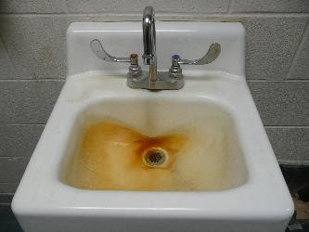
Facilities & Energy Management
13

Slide 14
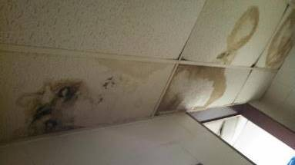
Facilities & Energy Management
13

Slide 15
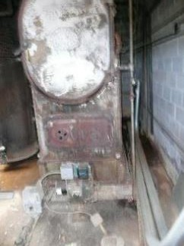
Facilities & Energy Management
13

Slide 16
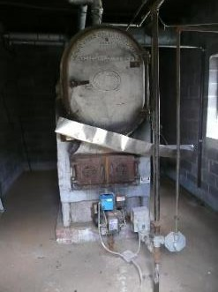
Facilities & Energy Management
13

Slide 17
Facilities & Energy Management
(SELECTED GLOBAL FINDINGS/FUTURE CONSIDERATION)
Three of the four districts do not have a five- year master plan.
Two of the four districts do not have the staff knowledge required to determine energy conservation and efficiency measures and how to perform preventative maintenance on the HVAC equipment to reduce excessive energy use and costly equipment failures.
Two of the four districts do not calculate current and projected enrollment capacity and utilization rates by school or grade-levels.

Slide 18
Facilities & Energy Management
(SELECTED GLOBAL FINDINGS/FUTURE CONSIDERATION)
Three of the four districts had an extended warranty contract with HARRIS Integrated Solutions to maintain and support their building automation system , but were unaware that the contract provided low-cost/free services HARRIS has available for energy conservation and efficiency measures.
Two of the four districts had a large backlog of deferred maintenance resulting in excessive energy use, frequent repairs of aging HVAC equipment , and reoccurring roofing leaks.
Reportedly slow response time from the Office of School Facilities (OSF) at the State Department of Education is delaying school construction.

Slide 19
Transportation
(SELECTED GLOBAL FINDINGS/FUTURE CONSIDERATION)
The training, staffing and facility requirements to have a safe and effective school transportation program are not synonymous with school districts that have less than 800 students.
School districts are not taking advantage of state programs that offer reduced pricing for fuel.
Districts are not competitively procuring vehicle maintenance, repair, and inspection services; instead they are supporting local vehicle services businesses for these services at often much higher prices.

Slide 20
Transportation
(SELECTED GLOBAL FINDINGS/FUTURE CONSIDERATION)
Small districts, less than 40 buses, should utilize technical assistance offered by the SDE Office of Transportation.
Small districts do not manage their vehicle preventive maintenance effectively.
Districts contracting for transportation services should always retain district staff with the expertise to constantly monitor contract compliance and district needs.

Slide 21
Food Services
(SELECTED GLOBAL FINDINGS/FUTURE CONSIDERATION)
The state of South Carolina purchasing consortium has been successful in helping districts secure quality food products at reasonable cost. However, all of the districts can benefit from assistance with menu development.
Smaller districts demonstrated difficulty in securing or making use of menu analysis, & inventory or point of sales software.

Slide 22
Technology Management
(SELECTED GLOBAL FINDINGS/FUTURE CONSIDERATION)
Districts are not maximizing their E-Rate Federal Program discounts which provides opportunities for schools and libraries to obtain discounts for services related to delivery of Internet and networks in schools.

Slide 23
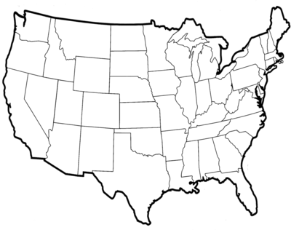
Other states have similar statewide school district efficiency review programs…
 COMMONWEALTH OF VIRGINIA STATEWIDE EFFICIENCY PROGRAM
http://www.doe.virginia.gov/school_finance/efficiency_reviews/index.shtml
 TEXAS LEGISLATIVE BUDGET BOARD EFFICIENCY AUDITS
http://www.lbb.state.tx.us/TeamPage.aspx?Team=SchoolPerfRev
 WEST VIRGINIA STATEWIDE EFFICIENCY REVIEW PROGRAM
http://www.governor.wv.gov/Pages/Search.aspx?q=efficiency
 WASHINGTON STATE AUDITOR’S EFFICIENCY AUDITS
http://portal.sao.wa.gov/ReportSearch/Home/ViewReportFile?arn=1000004&isFindin g=false&sp=false
 OKLAHOMA SCHOOL PERFORMANCE REVIEW
http://www.ok.gov/oeqa/Oklahoma_School_Performance_Review/

Slide 24
FUTURE EFFICIENCY REVIEW STUDY RECOMMENDATIONS
Include curriculum and instruction/special programs
Include food services
Work with the SC Department of Education to keep In$ite data updated (most recent is 2011-12)
Work with the SC Department of Education on pre-planning of onsite visits

Slide 25
FUTURE EFFICIENCY REVIEW STUDY RECOMMENDATIONS
Consider parts of various other state’s models to create one unique to SC (i.e., Virginia’s 50 % implementation rule or pay back 25% cost of the study)
Consider creating review protocols specific to SC school districts
Consider setting up a statewide best practices database

Slide 26
Questions and Answers
Ritchie Tidwell, Tidwell & Associates, Inc.
803-772-8985, tidwell@grantmaster.org
JoAnn Cox, JJC & Associates
850-284-2945, jjcandassociates@gmail.com

